Slide 1


Term Life Insurance

Slide 2
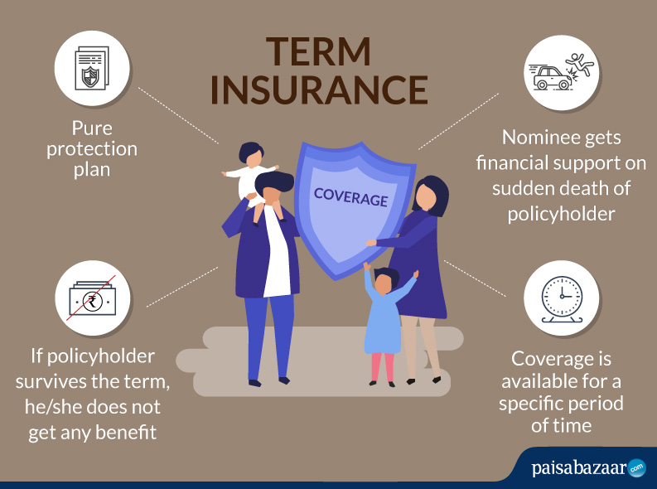
Notes:
Term Insurance Plans do not give anything back at the end of the term (life cover period) if you outlive it, meaning that there is only Death Benefit without maturity/survival benefit.

Slide 3

WHY TERM INSURANCE?
To protect against the financial loss of the family & help it sustain, after the untimely death of the bread-earner
House Rent/ Household
Groceries
EMI
School Fee
Retirement Plan
E
X
P
E
N
S
E
S

Slide 4
WHY TERM INSURANCE?
Term insurance is the most important insurance which every earning member of the family should buy. We are taking this insurance for our family and not for us.
Term insurance is for Family Protection – an income replacement for the family after the demise of bread-earner.
If we care about our family and love them, our first priority becomes our family protection .
We have maintained our family lifestyle according to our current earning situation, so we will definitely want to give them the same lifestyle even if we are not there .

Slide 5
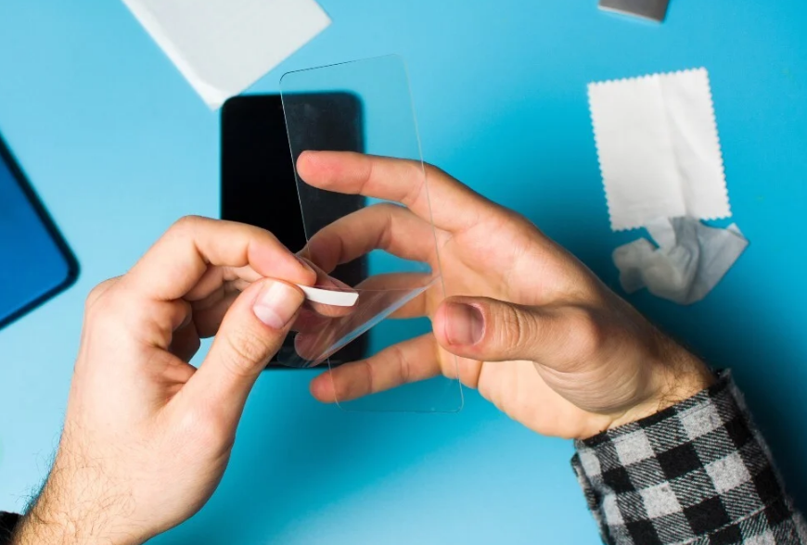
ON-CALL PITCH FOR TERM INSURANCE
Life is unpredictable for everyone; if anything unpredictable will happen to policyholder then this amount will provide support to the family members of the policyholder. Everyone knows their Date of Birth, but no one knows their Date of Death. Just like the way we protect our mobile phones with tempered glass, we need to protect our life with Term Plan.
As we can plan for the best but we should always be prepared for the worst .

Slide 6
Human Life Value: How much Cover should I Buy?
Ages | Multiplier
18-30 | 25
31-35 | 20
36-40 | 18
41-45 | 15
46-50 | 12
51-55 | 10
Age 56 & above | 5
Note: Gross Annual Income/CTC is considered

Slide 7
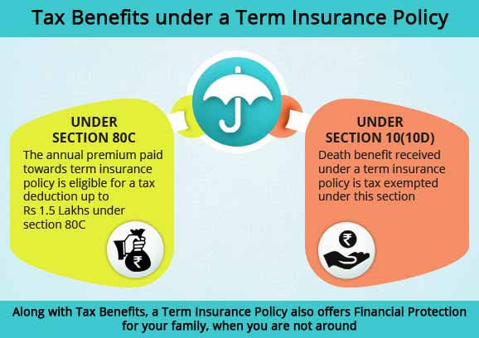
Tax Benefit

Slide 8





Riders
Terminal Illness
Accidental Death Benefit
Accidental Disability
Waiver of Premium
Critical Illness

Slide 9
Quiz Time
Who designs the plan and calculates the basic premium ?
A
B
Underwriter
Third Party Administrative
C
D
Actuary
The Insurer

Slide 10
Quiz Time
Term plan Offers
A
B
Only Death Benefit
Only Maturity Benefit
C
D
Death and Maturity Benefit
No Benefit

Slide 11
Quiz Time
The Annual premium paid towards Term Insurance policy is eligible for a tax deduction up to Rs 1.5lac under section _____________
A
B
80C
80D
C
D
10(10D)
10(10C)

Slide 12
Quiz Time
Deepak bought an online policy. He received the policy bond and is not satisfied with the terms and condition of the contract and wants to cancel it. He can do so:
A
B
Within 15 days
Within 30 days
C
D
Within 45 days
Within 60 days

Slide 13
Quiz Time
Death Benefit Received under a Term Insurance Policy is exempted under
A
B
80C
80D
C
D
10(10D)
10(10C)

Slide 14
Quiz Time
__________________ is the process of checking the risk of customer.
A
B
Underwriting
Actuary
C
D
Third Party Administrative
The Insurer

Slide 15
Quiz Time
They are some common riders:
A
B
Accidental death benefit rider
Critical Illness Rider
C
D
Waiver of premium rider
All of them

Slide 16


